Slide 1


Azərbaycan Dövlət Neft və Sənaye Universiteti
Calculus
Single Variable

Slide 2
Related Rates

Slide 3

You have already seen how the Chain Rule can be used to find $\frac{dy}{dx}$ implicitly.
Another important use of the Chain Rule is to find the rates of change of two or more related variables that are changing with respect to time.

Slide 4
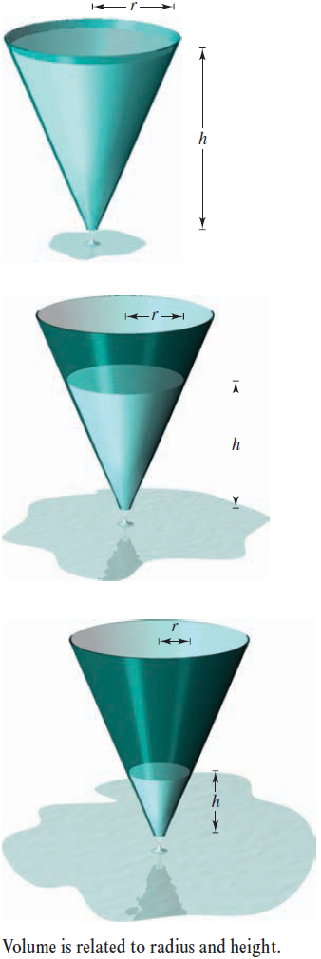
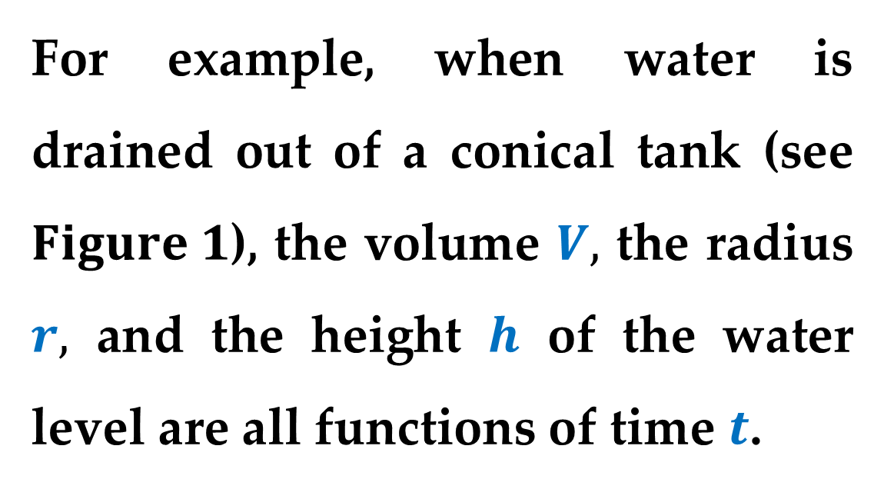
For example, when water is drained out of a conical tank (see $Figure 1$), the volume $V,$ the radius $r,$ and the height $h$ of the water level are all functions of time $t$.

Slide 5
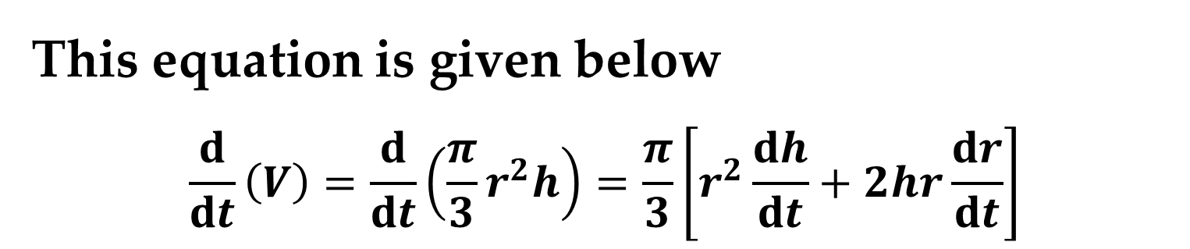
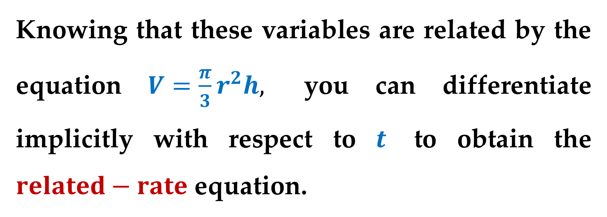
Knowing that these variables are related by the equation $V=\frac{π}{3}r^{2}h,$ you can differentiate implicitly with respect to $t$ to obtain the $related−rate$ equation.
This equation is given below
$$\frac{d}{dt}\left(V\right)=\frac{d}{dt}\left(\frac{π}{3}r^{2}h\right)=\frac{π}{3}\left[r^{2}\frac{dh}{dt}+2hr\frac{dr}{dt}\right]$$

Slide 6
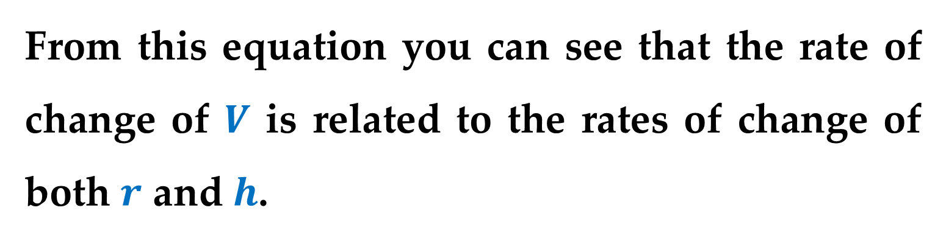
From this equation you can see that the rate of change of $V$ is related to the rates of change of both $r$ and $h$.

Slide 7
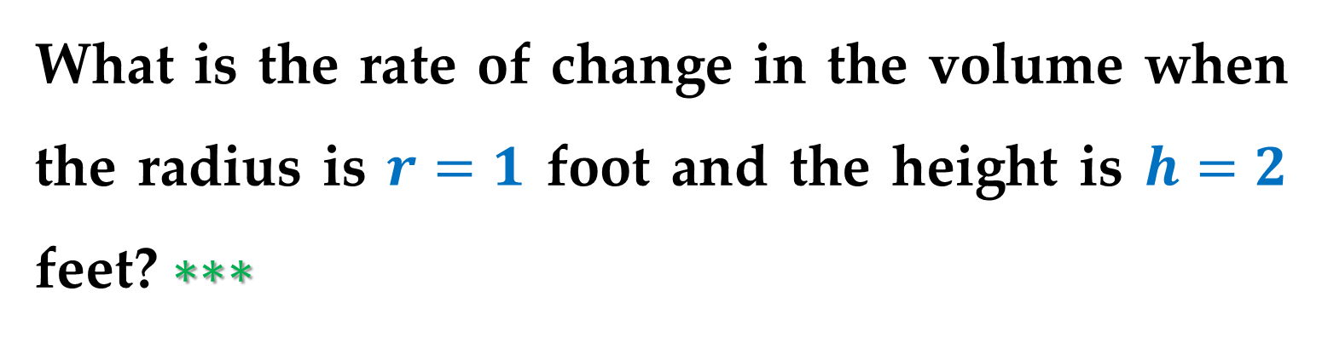
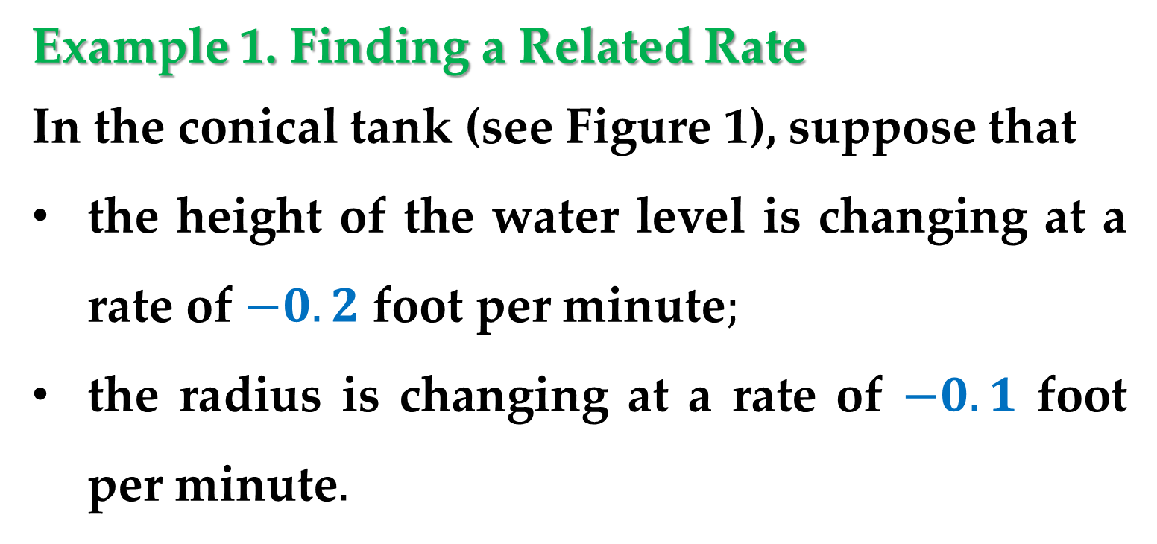
Example 1. Finding a Related Rate
In the conical tank (see Figure 1), suppose that
the height of the water level is changing at a rate of $−0.2$ foot per minute$;$
the radius is changing at a rate of $−0.1$ foot per minute$.$
What is the rate of change in the volume when the radius is $r=1$ foot and the height is $h=2$ feet? $∗∗∗$

Slide 8
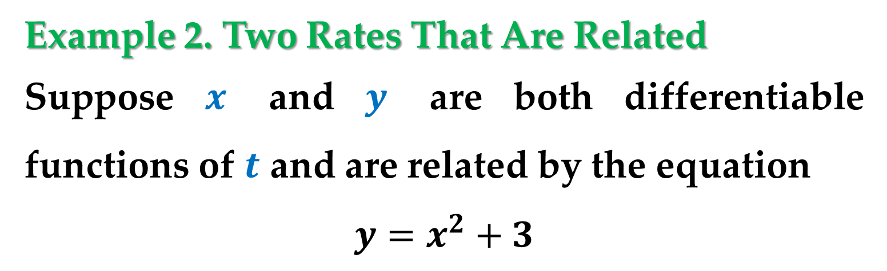
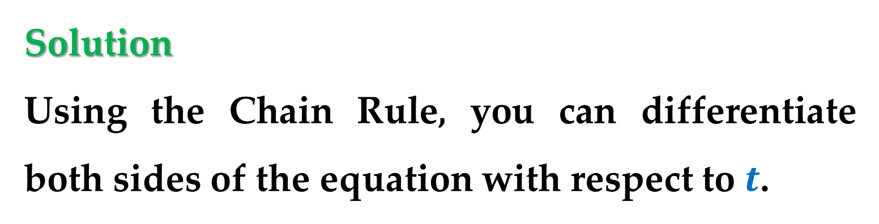
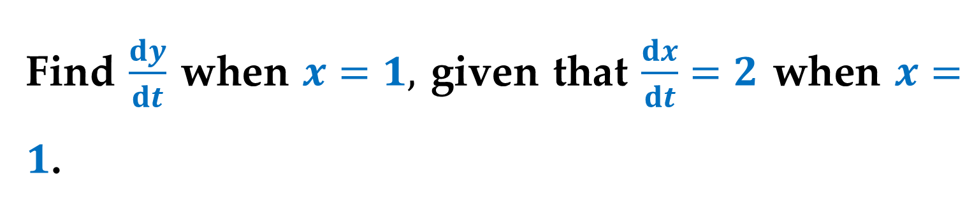
Example 2. Two Rates That Are Related
Suppose $x$ and $y$ are both differentiable functions of $t$ and are related by the equation
$$y=x^{2}+3$$
Find $\frac{dy}{dt}$ when $x=1,$ given that $\frac{dx}{dt}=2$ when $x=1$.
Solution
Using the Chain Rule, you can differentiate both sides of the equation with respect to $t$.

Slide 9
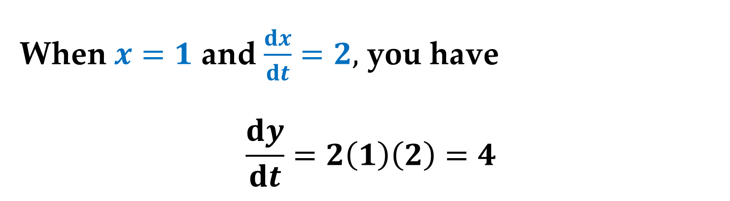
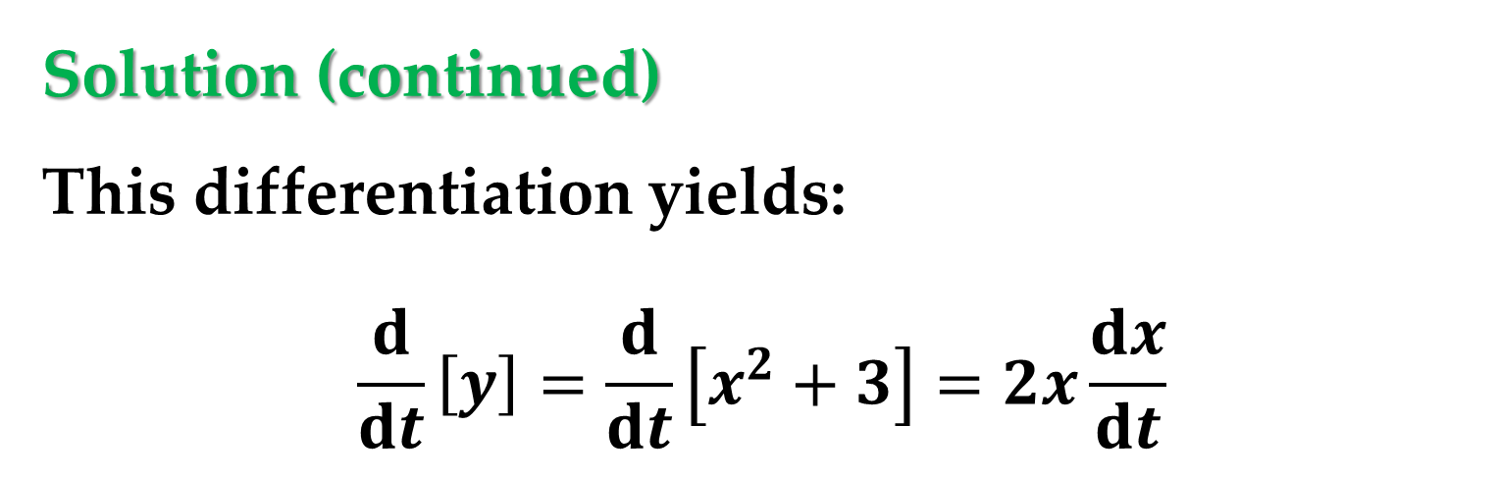
Solution (continued)
This differentiation yields:
$$\frac{d}{dt}\left[y\right]=\frac{d}{dt}\left[x^{2}+3\right]=2x\frac{dx}{dt}$$
When $x=1$ and $\frac{dx}{dt}=2,$ you have
$$\frac{dy}{dt}=2\left(1\right)\left(2\right)=4$$

Slide 10
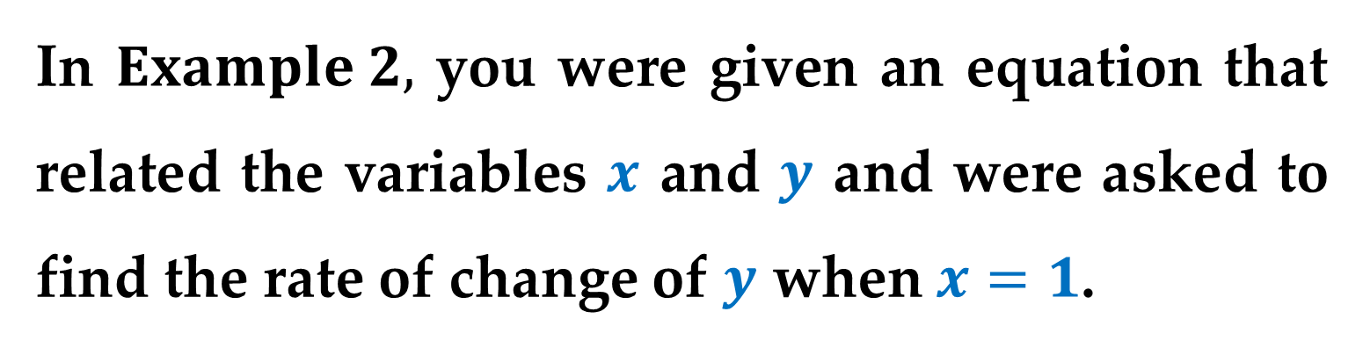
In $Example 2,$ you were given an equation that related the variables $x$ and $y$ and were asked to find the rate of change of $y$ when $x=1$.
In each of the remaining examples in this lecture, you must create a mathematical model from a verbal description.

Slide 11
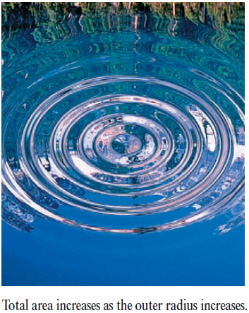
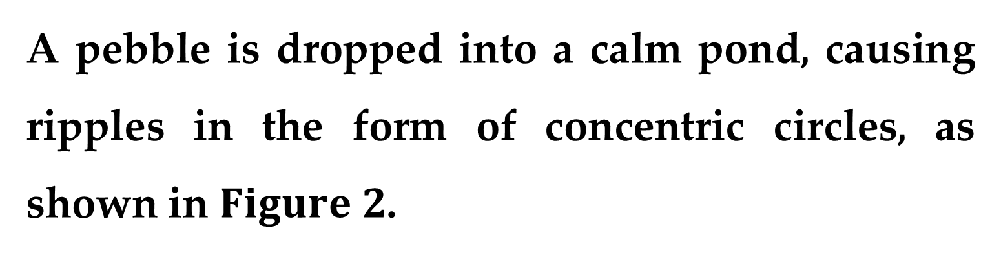
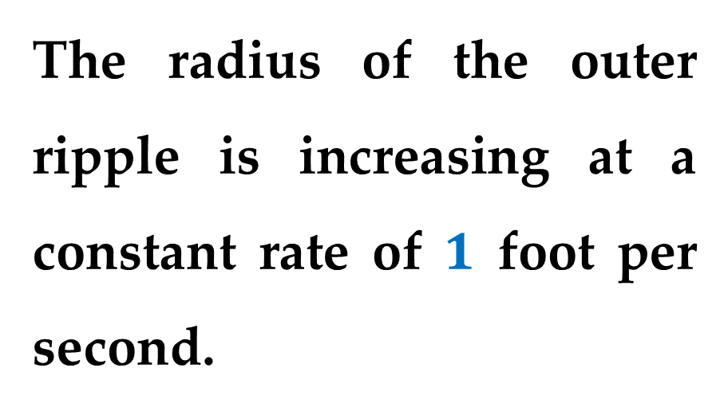
Example 3. Ripples in a Pond
A pebble is dropped into a calm pond, causing ripples in the form of concentric circles, as shown in $Figure 2$.
The radius of the outer ripple is increasing at a constant rate of $1$ foot per second.

Slide 12
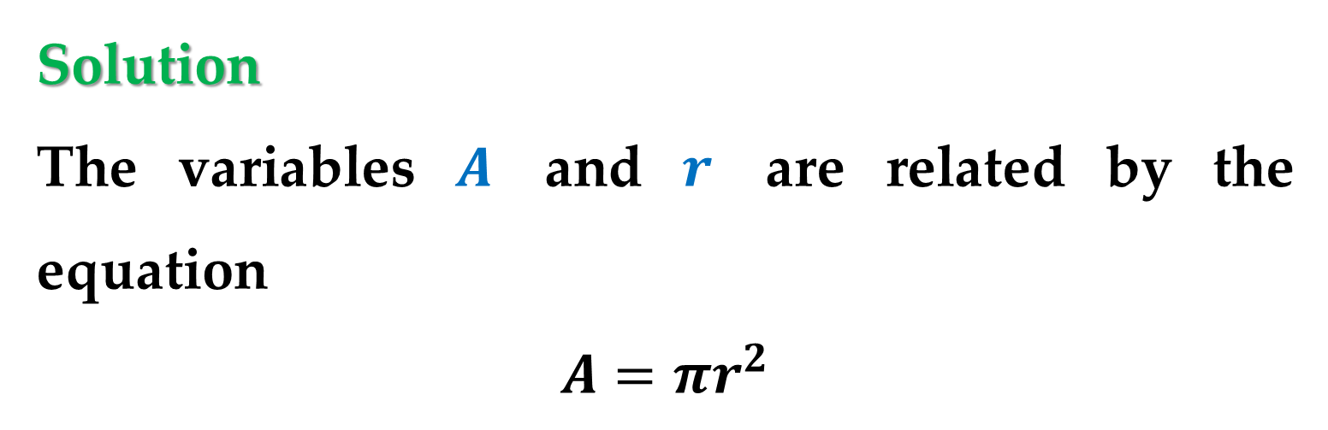
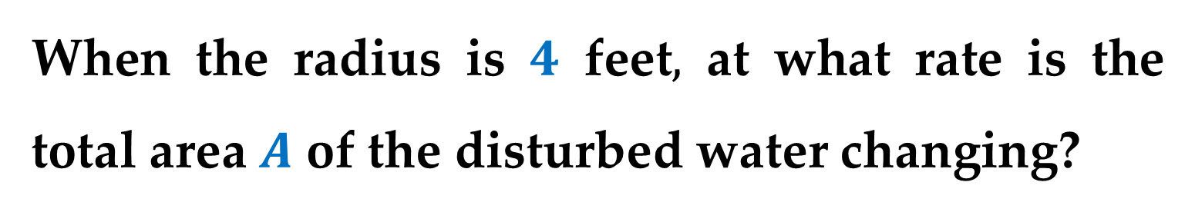
Example 3. Ripples in a Pond (continued)
When the radius is $4$ feet$,$ at what rate is the total area $A$ of the disturbed water changing?
Solution
The variables $A$ and $r$ are related by the equation
$$A=πr^{2}$$

Slide 13
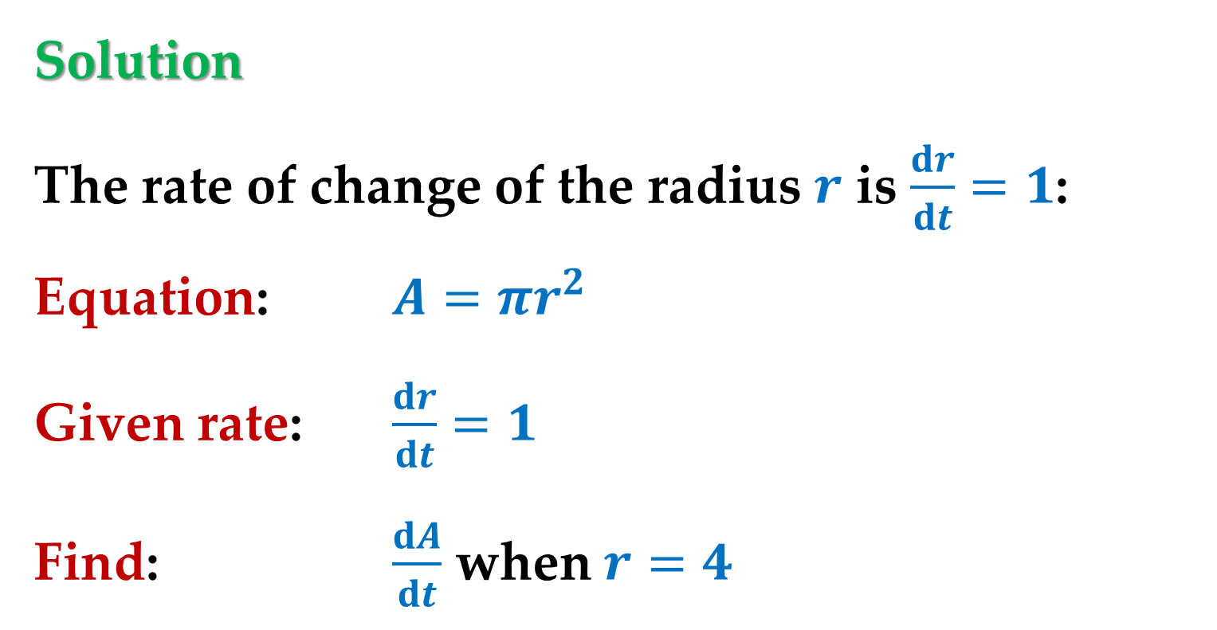
Solution
The rate of change of the radius $r$ is $\frac{dr}{dt}=1$:
Equation: $A=πr^{2}$
Given rate: $\frac{dr}{dt}=1$
Find: $\frac{dA}{dt}$ when $r=4$

Slide 14
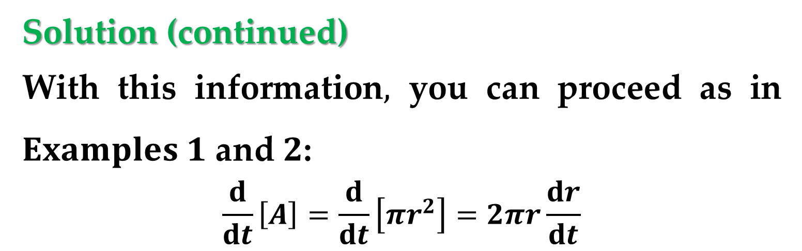
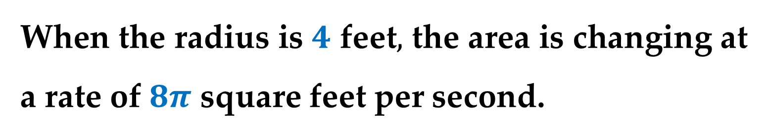
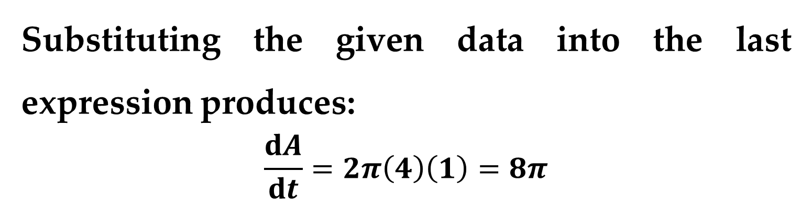
Solution (continued)
With this information$,$ you can proceed as in $Examples 1$ and $2$:
$$\frac{d}{dt}\left[A\right]=\frac{d}{dt}\left[πr^{2}\right]=2πr\frac{dr}{dt}$$
Substituting the given data into the last expression produces:
$$\frac{dA}{dt}=2π\left(4\right)\left(1\right)=8π$$
When the radius is $4$ feet$,$ the area is changing at a rate of $8π$ square feet per second.

Slide 15
Guidelines for Solving Related-Rate Problems
Identify all given quantities and quantities to be determined. Make a sketch and label the quantities.
Write an equation involving the variables whose rates of change either are given or are to be determined.

Slide 16
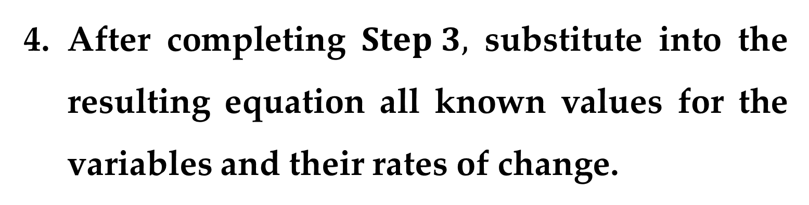
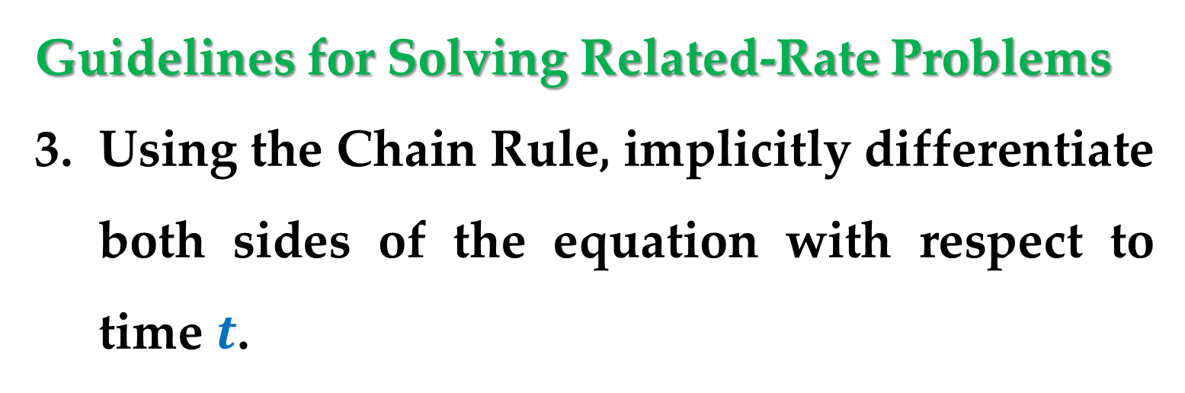
Guidelines for Solving Related-Rate Problems
Using the Chain Rule, implicitly differentiate both sides of the equation with respect to time $t$.
After completing $Step 3,$ substitute into the resulting equation all known values for the variables and their rates of change.
Then solve for the required rate of change.

Slide 17
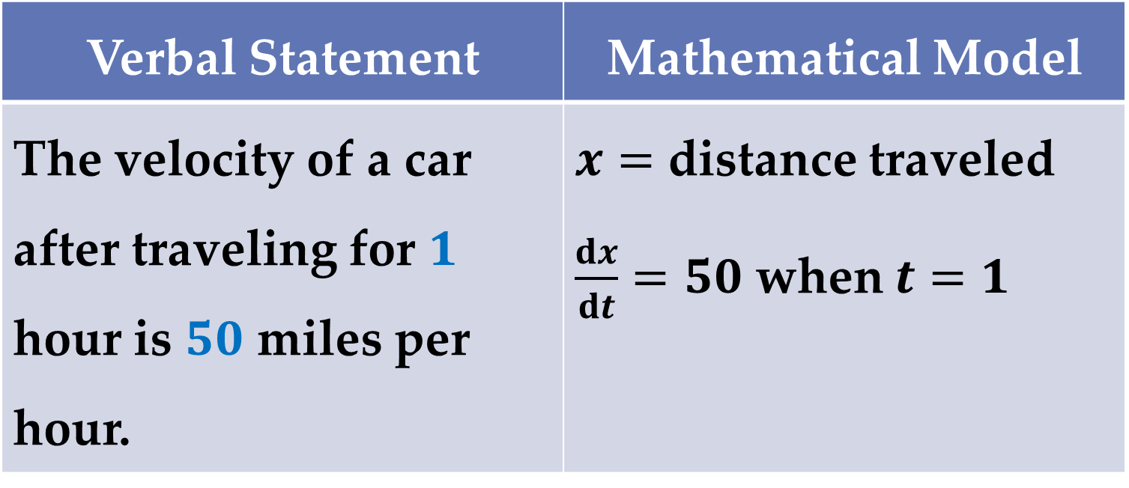
The table below lists examples of mathematical models involving rates of change.
Verbal Statement | Mathematical Model
The velocity of a car after traveling for $1$ hour is $50$ miles per hour. | $x=$ distance traveled $\frac{dx}{dt}=50$ when $t=1$

Slide 18
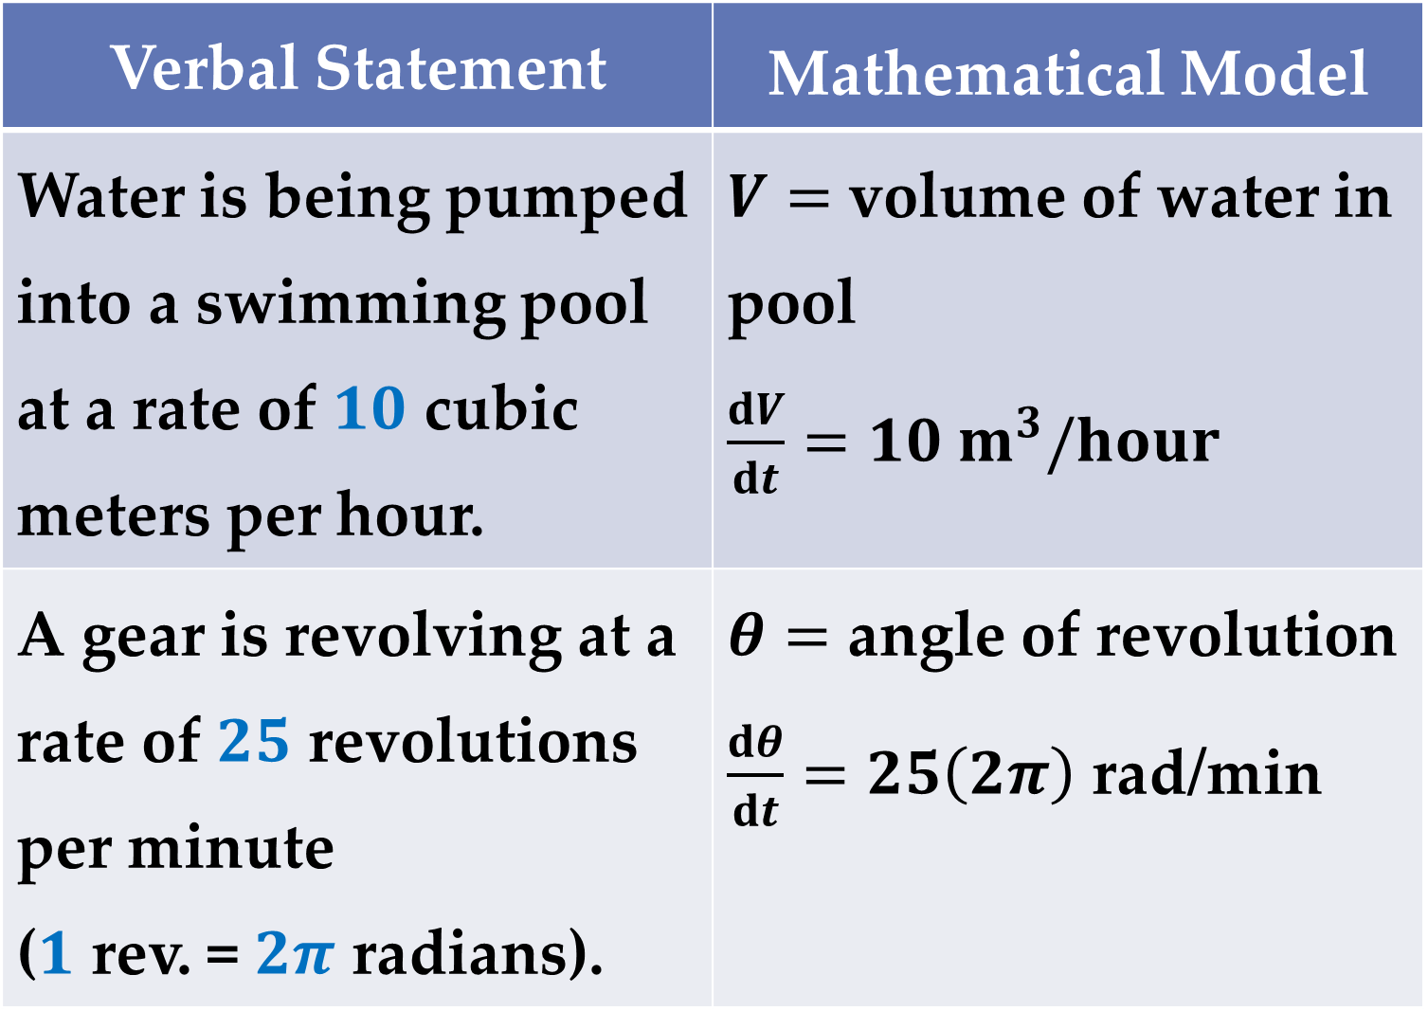
Verbal Statement | Mathematical Model
Water is being pumped into a swimming pool at a rate of $10$ cubic meters per hour. | $V=$ volume of water in pool $\frac{dV}{dt}=10 m^{3}/hour$
A gear is revolving at a rate of $25$ revolutions per minute ($1$ rev. = $2π$ radians). | $θ=$ angle of revolution $\frac{dθ}{dt}=25\left(2π\right)$ rad/min

Slide 19
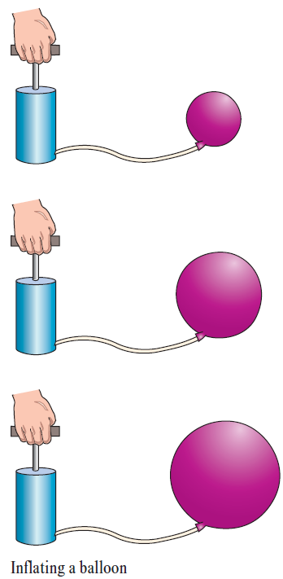
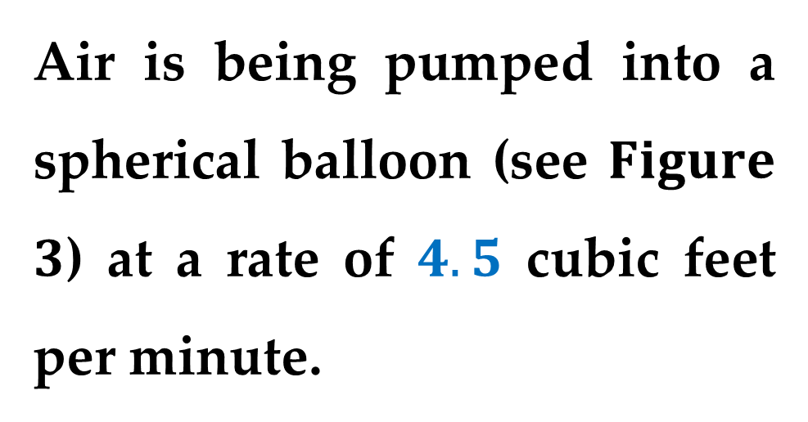
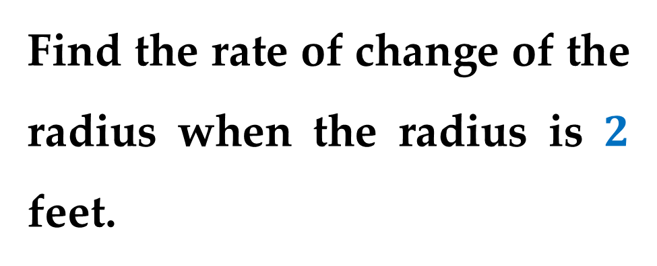
Example 4. An Inflating Balloon
Air is being pumped into a spherical balloon (see $Figure$ $3$) at a rate of $4.5$ cubic feet per minute.
Find the rate of change of the radius when the radius is $2$ feet.

Slide 20
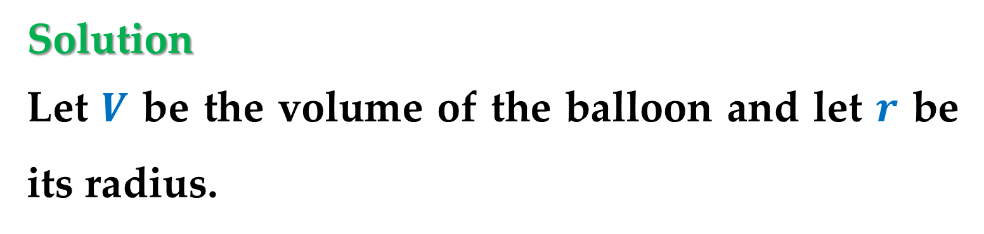
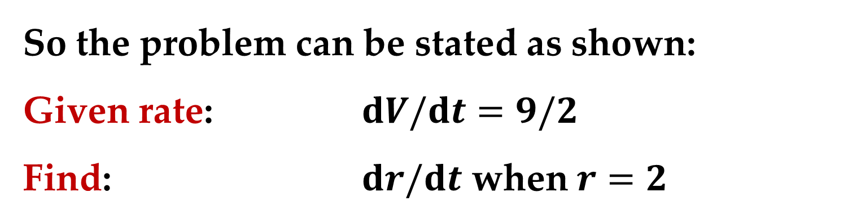
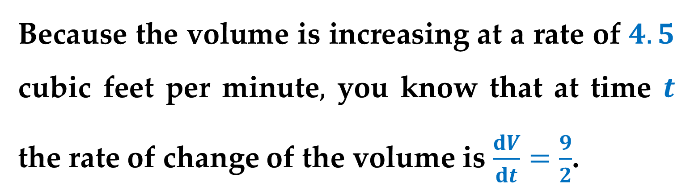
Solution
Let $V$ be the volume of the balloon and let $r$ be its radius.
Because the volume is increasing at a rate of $4.5$ cubic feet per minute$,$ you know that at time $t$ the rate of change of the volume is $\frac{dV}{dt}=\frac{9}{2}$.
So the problem can be stated as shown:
Given rate: $dV/dt=9/2$
Find: $dr/dt$ when $r=2$

Slide 21
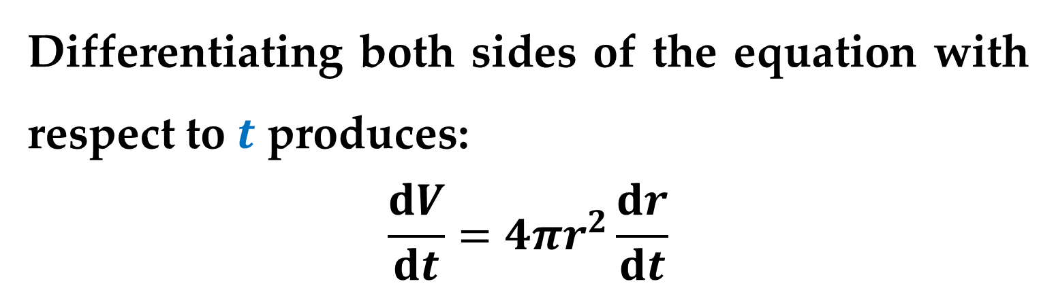
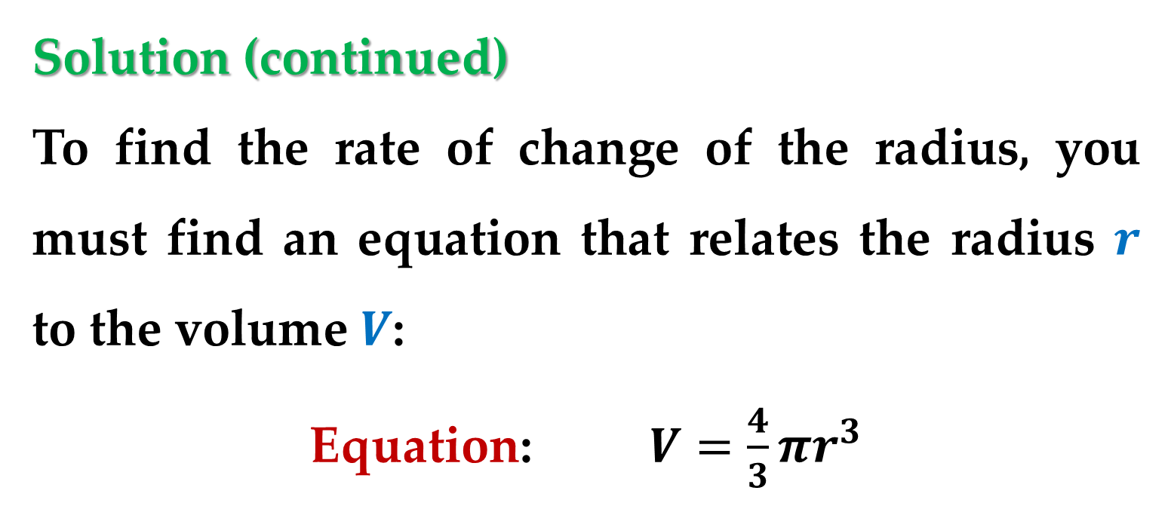
Solution (continued)
To find the rate of change of the radius, you must find an equation that relates the radius $r$ to the volume $V$:
Equation: $V=\frac{4}{3}πr^{3}$
Differentiating both sides of the equation with respect to $t$ produces:
$$\frac{dV}{dt}=4πr^{2}\frac{dr}{dt}$$

Slide 22
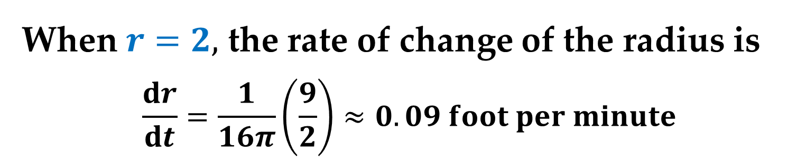
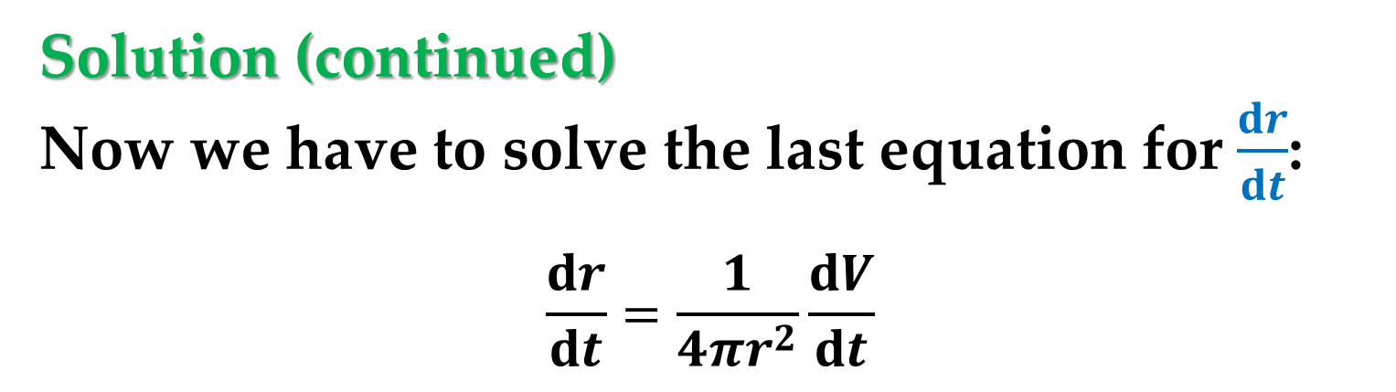
Solution (continued)
Now we have to solve the last equation for $\frac{dr}{dt}$:
$$\frac{dr}{dt}=\frac{1}{4πr^{2}}\frac{dV}{dt}$$
When $r=2,$ the rate of change of the radius is
$$\frac{dr}{dt}=\frac{1}{16π}\left(\frac{9}{2}\right)≈0.09 foot per minute$$
Note in this Example, that the volume is increasing at a constant rate but the radius is increasing at a variable rate.

Slide 23
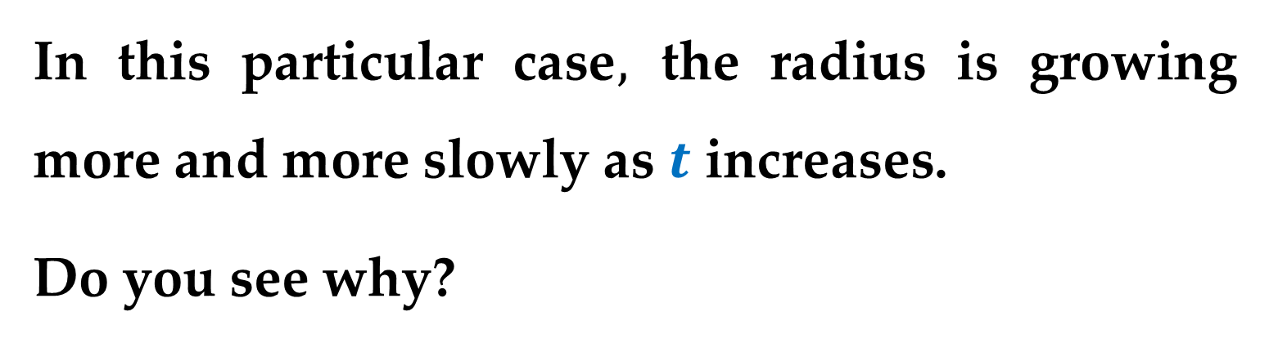
Afterthought
Just because two rates are related does not mean that they are proportional.
In this particular case$,$ the radius is growing more and more slowly as $t$ increases.
Do you see why?

Slide 24
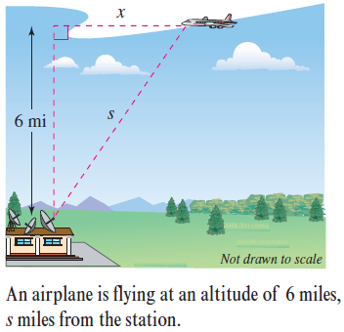
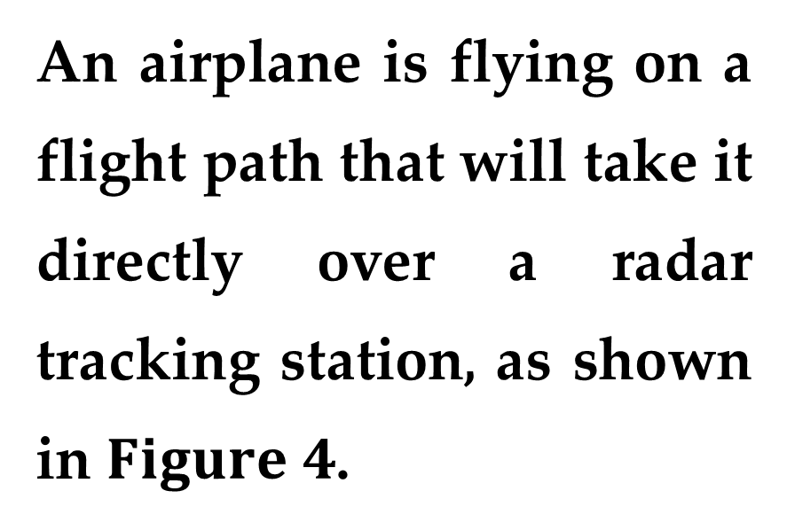
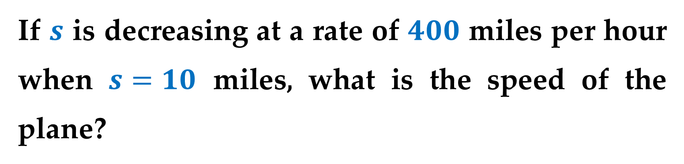
Example 5. The Speed of an Airplane Tracked
by Radar
An airplane is flying on a flight path that will take it directly over a radar tracking station, as shown in $Figure 4$.
If $s$ is decreasing at a rate of $400$ miles per hour when $s=10$ miles, what is the speed of the plane?

Slide 25
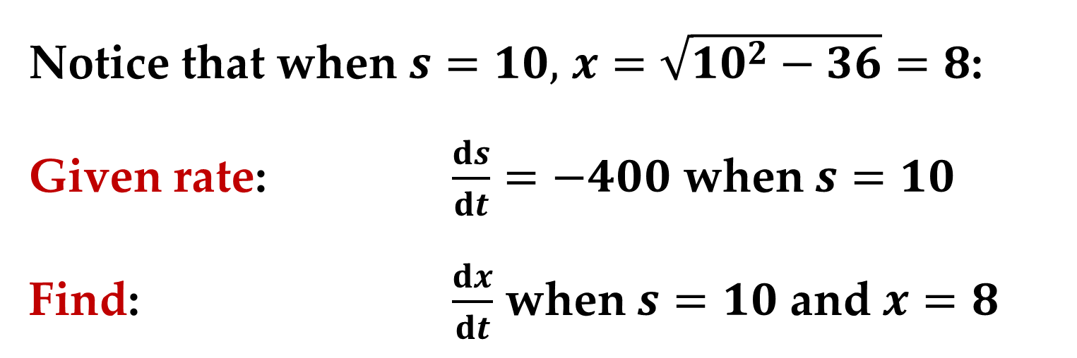
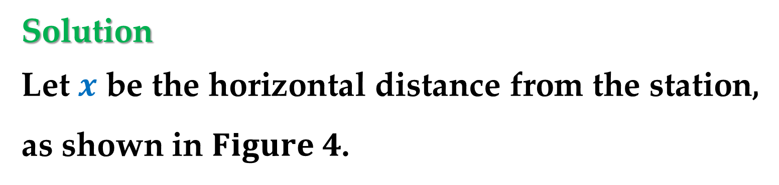
Solution
Let $x$ be the horizontal distance from the station, as shown in $Figure 4$.
Notice that when $s=10,$ $x=\sqrt{10^{2}−36}=8$:
Given rate: $\frac{ds}{dt}=−400$ when $s=10$
Find: $\frac{dx}{dt}$ when $s=10$ and $x=8$
Based on this information we can find the velocity of the plane as shown below.

Slide 26
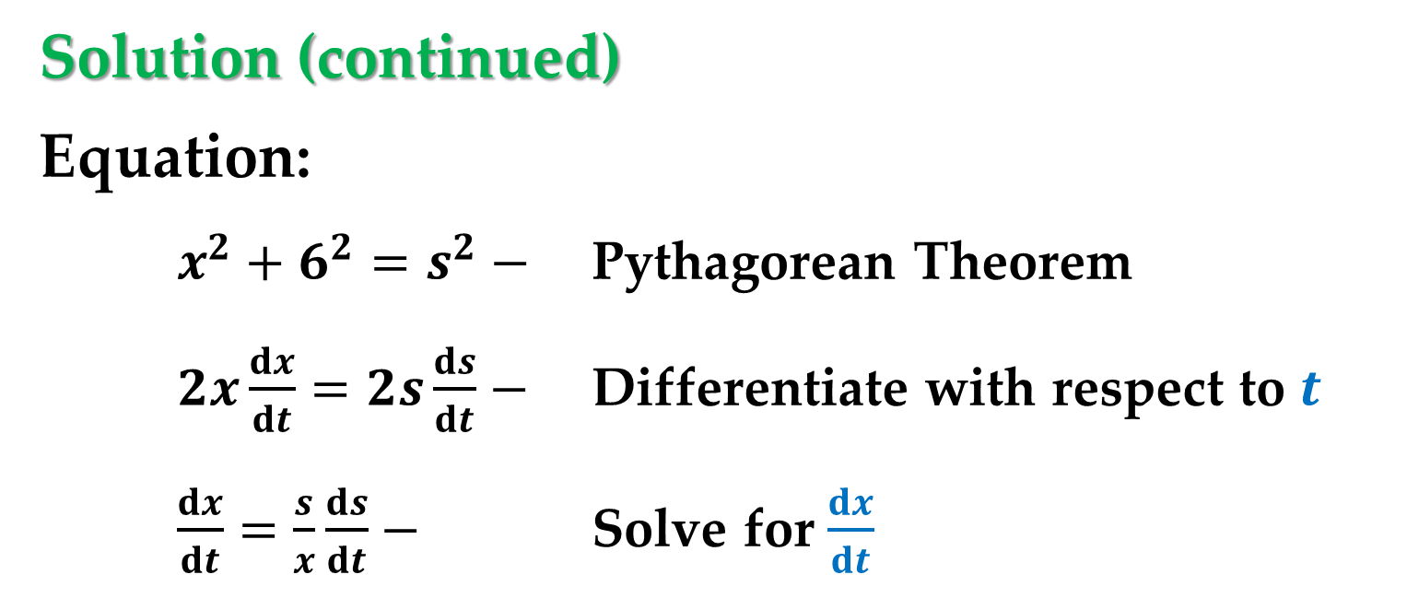
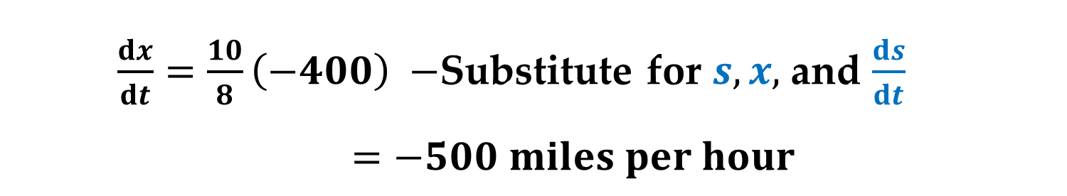

Solution (continued)
Equation:
$x^{2}+6^{2}=s^{2}−$ Pythagorean Theorem
$2x\frac{dx}{dt}=2s\frac{ds}{dt}−$ Differentiate with respect to $t$
$\frac{dx}{dt}=\frac{s}{x}\frac{ds}{dt}−$ Solve for $\frac{dx}{dt}$
$\frac{dx}{dt}=\frac{10}{8}\left(−400\right) −$Substitute for $s,x,$ and $\frac{ds}{dt}$
$=−500$ $miles per hour$
Because the velocity is $−500,$ the speed is $500$.

Slide 27
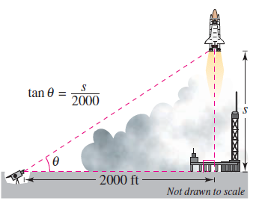
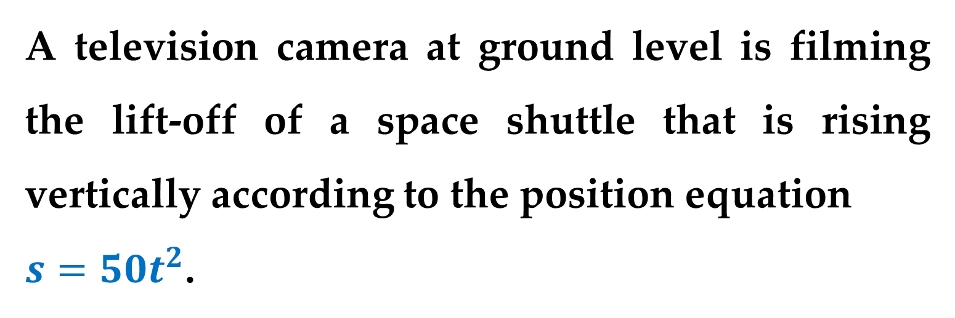
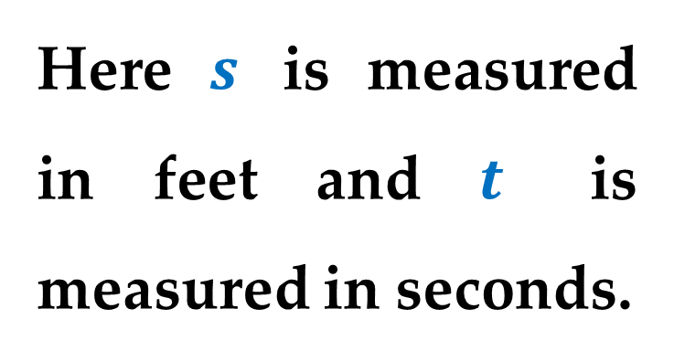
Example 6. A Changing Angle of Elevation
A television camera at ground level is filming the lift-off of a space shuttle that is rising vertically according to the position equation
$s=50t^{2}$.
Here $s$ is measured in feet and $t$ is measured in seconds.

Slide 28
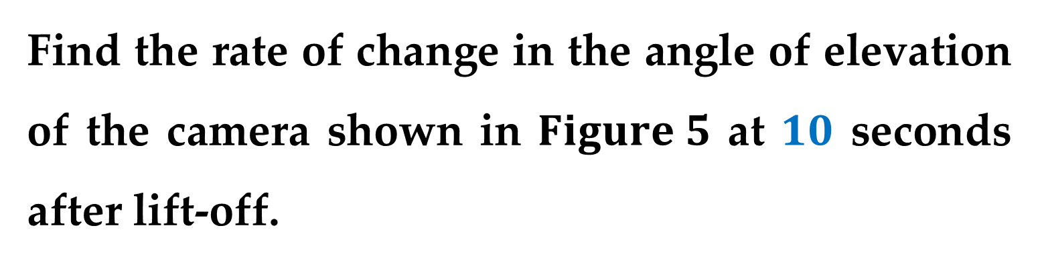

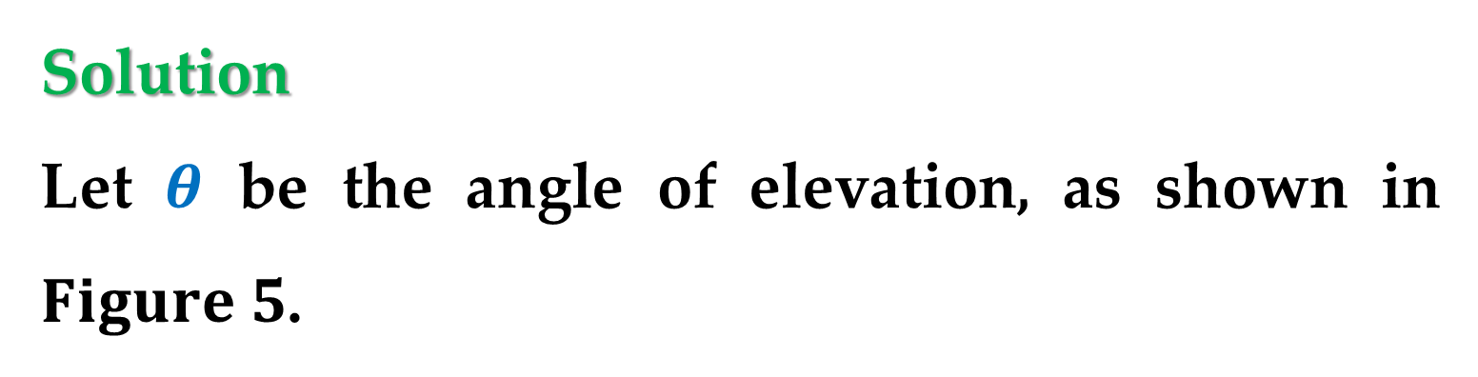
Example 6. A Changing Angle of Elevation
The camera is $2000$ feet away from the launch pad.
Find the rate of change in the angle of elevation of the camera shown in $Figure 5$ at $10$ seconds after lift-off.
Solution
Let $θ$ be the angle of elevation, as shown in $Figure 5$.

Slide 29
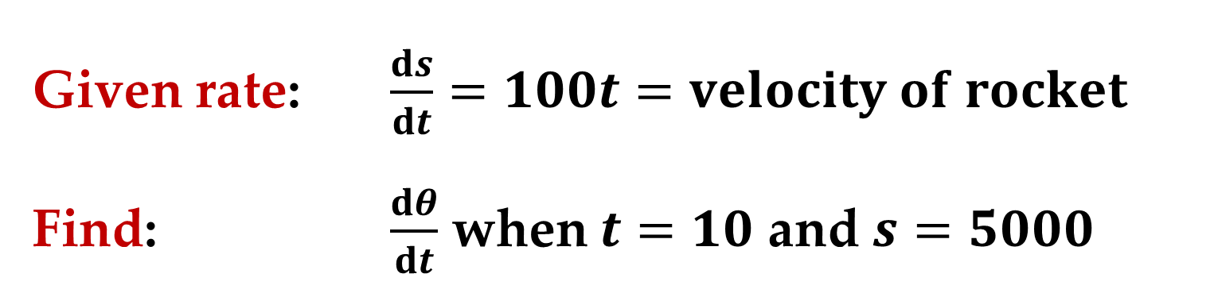

Solution (continued)
When $t=10,$ the height of the rocket
$$s=50t^{2}=50\left(10^{2}\right)=5000 feet$$
Given rate: $\frac{ds}{dt}=100t=velocity of rocket$
Find: $\frac{dθ}{dt}$ when $t=10$ and $s=5000$

Slide 30


Solution (continued)
Using $Figure 5,$ you can relate $θ$ and $s$ by the equation
$$\tan{θ}=\frac{s}{2000}$$
Differentiate this equation with respect to $t$:
$${\left(\sec{θ}\right)}^{2}\frac{dθ}{dt}=\frac{1}{2000}\frac{ds}{dt}$$

Slide 31



Solution (continued)
$\frac{dθ}{dt}={\left(\cos{θ}\right)}^{2}\frac{100t}{2000}−$ substitute $100t$ for $\frac{ds}{dt}$
$$\frac{dθ}{dt}={\left(\frac{2000}{\sqrt{s^{2}+2000^{2}}}\right)}^{2}\frac{100t}{2000}$$
When $t=10$ and $s=5000,$ you have
$$\frac{dθ}{dt}=\frac{2}{29} radian per second$$

Slide 32




Example 6. The Velocity of a Piston
In the engine shown in $Figure 6,$ a $7−$inch connecting rod is fastened to a crank of radius $3$ inches.
The crankshaft rotates counterclockwise at a constant rate of $200$revolutions per minute.
Find the velocity of the piston when $θ=\frac{π}{3}$.

Slide 33



Example 6. The Velocity of a Piston (continued)
The velocity of a piston is related to the angle of the crankshaft.
Solution
Label the distances as
shown in $Figure 7$.
Because a complete revolution corresponds to $2π$ radians$,$ it follows that
$dθ/dt$ $=200 \left(2π\right)=400 π$ radians per minute

Slide 34



Solution (continued)
Given rate: $\frac{dθ}{dt}=400 π$ (constant rate)
Find: $\frac{dx}{dt}$ when $θ=\frac{π}{3}$
You can use the Law of Cosines ($Figure 8$) to find an equation that
relates $x$ and $θ$.

Slide 35



Solution (continued)
Equation:
$$7^{2}=3^{2}+x^{2}−2\left(3\right)\left(x\right)\cos{θ}$$
$$0=2x\frac{dx}{dt}−6\left(−x\sin{θ}\frac{dθ}{dt}+\cos{θ}\frac{dx}{dt}\right)$$
$$\frac{dx}{dt}=\frac{6x\sin{θ}}{6\cos{θ}−2x}\frac{dθ}{dt}$$

Slide 36


Solution (continued)
When $θ=\frac{π}{3}$ you can solve for $x$ as shown:
$$7^{2}=3^{2}+x^{2}−2\left(3\right)\left(x\right)\cos{\frac{π}{3}}$$
$$49=9+x^{2}−6x\left(0.5\right)$$
$$x^{2}−3x−40=0$$
Roots: $x=8, −5$

Slide 37


Solution (continued)
So when $x=8$ and $θ=\frac{π}{3}$ the velocity of the piston is
$$\frac{dx}{dt}=\frac{9600π\sqrt{3}}{−13}≈−4018 inches per minute$$
Note that the velocity in $Example 6$ is negative because it represents a distance that is decreasing.

Slide 38
Thank you for attention

